Slide 1
AI Updates
June 20, 2025
Crowd-sourced "LM Arena" Leaderboard
Google Gemini 2.5 are now "generally available"
"AI or Die" - post by Ravi Gupta
No more TensorFlow/Jax
Apple Foundation Models (AFM) family
MiniMax-M1 - open 456B reasoning model
"Kangaroo" video model
Moonshot Kimi-Dev-72B open LLM for SWE
Anysphere (Cursor AI) gets $20 Bln valuation
Digital Avatars outsell humans
OpenAI lands $200M Pentagon contract
Hexagon Robotics uses Nvidia
Midjourney V1 image-to-video
Google AI Search Now Talks Back and Forth
proactor.ai
Nanobrowser Chrome Extension
OpenAI Demo - Creating Customer Service Agent
Neuro-Symbolic Data Generation for Math Reasoning
Base44 sells to Wix for $80M cash
Chris Lattner "Shape of Compute"
Anthropic Multi-Agent Research System
Self-Improving AI
Chinese use Nvidia Chips in other countries
AI Categorizes Objects Like Humans
New TokenBreak Attack Bypasses AI Moderation
Salesforce - AI Agents Fail 40% of simple CRM Tasks
80% of AI projects fail
models.dev - lists 140 AI models
OpenAI against Microsoft getting IP of Windsurf
Groq chips made Hugging Face way faster
Millions of Old Books for AI Training
TikTok's Symphony creates videos of virtual models
Claude Code vs Cursor
Andrej Karpathy - Software 3.0
Why AI can code for 1h, but not 10h?
Inference with Sample/Verify
Google DeepMind Weather Models
Jobs, Layoffs

Slide 2
Crowd-sourced "LM Arena" Leaderboard
Starting Elo rating = 1000
https://en.wikipedia.org/wiki/Elo_rating_system
Text - June 17
Webdev - June 16
LM Arena secures $100M to expand AI benchmarking (at $600M valuation)
Model | Score
gemini-2.5-pro-preview-06-05 | 1470
o3-2025-04-16 | 1449
gemini-2.5-pro-preview-05-06 | 1446
chatgpt-4o-latest-20250326 | 1440
gpt-4.5-preview-2025-02-27 | 1434
claude-opus-4-20250514 | 1419
gemini-2.5-flash-preview-05-20 | 1417
deepseek-r1-0528 | 1411
gpt-4.1-2025-04-14 | 1410
grok-3-preview-02-24 | 1406
gemini-2.5-flash-preview-04-17 | 1405
qwen3-235b-a22b-no-thinking | 1395
deepseek-v3-0324 | 1396
o4-mini-2025-04-16 | 1396
o1-2024-12-17 | 1397
claude-sonnet-4-20250514 | 1394
deepseek-r1 | 1393
gemini-2.5-flash-lite-preview-06-17-thinking | 1387
claude-3-7-sonnet-20250219-thinking-32k | 1385
Model | Score
Gemini-2.5-Pro-Preview-06-05 | 1433
DeepSeek-R1-0528 | 1409
Gemini-2.5-Pro-Preview-05-06 | 1408
Claude Opus 4 (20250514) | 1406
Claude Sonnet 4 (20250514) | 1382
Claude 3.7 Sonnet (20250219) | 1357
Gemini-2.5-Flash-Preview-05-20 | 1305
GPT-4.1-2025-04-14 | 1257
Claude 3.5 Sonnet (20241022) | 1238
DeepSeek-V3-0324 | 1207
DeepSeek-R1 | 1198
o3-2025-04-16 | 1190
GPT-4.1-mini-2025-04-14 | 1189
Qwen3-235B-A22B | 1187
Mistral Medium 3 | 1174
Gemini-2.5-Flash-Preview-04-17 | 1157
o3-mini-high (20250131) | 1136
Claude 3.5 Haiku (20241022) | 1133
o4-mini-2025-04-16 | 1102
https://lmarena.ai/?leaderboard
https://openlm.ai/chatbot-arena/
https://beta.lmarena.ai
https://legacy.lmarena.ai
China
Web Leaderboard https://web.lmarena.ai/leaderboard
LLM Leaderboard - by @LlmStats https://llmworld.net/llm_leaderboards/
LLM Leaderboard - by StackAI https://www.stack-ai.com/llm-leaderboard
LLM Leaderboard - by Artificial Analysis https://artificialanalysis.ai/leaderboards/models
Open LLM Leaderboard - by Hugging Face https://huggingface.co/open-llm-leaderboard
LLM Leaderboard - by Vellum https://www.vellum.ai/llm-leaderboard
China
x.ai
China
China
China
China
China
M
China

Slide 3


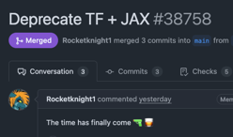
AI Updates 1
"AI or Die" - post by Ravi Gupta
https://www.youtube.com/watch?v=a-t28YkfdeY
https://www.rkg.blog/ai-or-die.php
https://www.sequoiacap.com/people/ravi-gupta/
AI is becoming better and becoming practical
It is growing into many aspects of our lives
It is a powerful force
It is killing jobs and businesses - and creating new opportunities
You need to pay attention to it, to adapt, to start using it
Full re-founding of your company is required
It is a matter of survival. you can not compete with it. You need to learn to use it
A horse buggy can not compete with modern cars, trucks, and trains. Knives and spears can not compete with machine guns and rockets
Whether you like it or not - you have to live with it and to use it
Google Gemini 2.5 are now "generally available"
This means they are stable and ready for production use
Gemini 2.5 Flash-Lite - in preview - fast and low cost ($0.10/$0.40) - for translation and classification https://blog.google/products/gemini/gemini-2-5-model-family-expands/
No more TensorFlow/Jax
Hugging Face transformer library abandons/deprecates TensorFlow/Jax in favor of PyTorch
https://x.com/clefourrier/status/1933271084650189263
Apple Foundation Models (AFM) family
Smaller on-device and larger server-hosted versions
Foundation Models framework (an API)
Input/output: Text, images in (up to 65,000 tokens), text out
AFM-on-device: 3B params, 300M param vision transformer
AFM-server: MoE (size undisclosed), 1B-params vision transformer
Tool use, 15 languages, vision, image understanding
AFM-server not available for public use
Output token limit is undisclosed

Slide 4
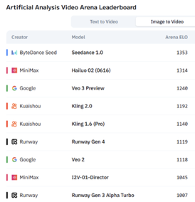
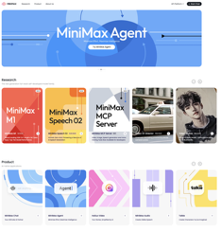

AI Updates 2
MiniMax-M1 - open 456B reasoning model
MiniMax-M1 is the world's first open-weight, large-scale hybrid-attention reasoning model; the second most intelligent open weights model after DeepSeek R1
MiniMax - startup from Shanghai, China, ~1K employees
massive 456 billion parameters
MoE (45.9 B activated per token)
1 Million token context window
40K and 80K "thinking budget" versions
On par or better than leading commercial models like Gemini 2.5 Pro
https://huggingface.co/MiniMaxAI/MiniMax-M1-80k
https://www.minimax.io
"Kangaroo" video model (#2 on Artificial Analysis Video Arena Leaderboard) reveals itself as "Hailuo 02 (0616)", from MiniMax.
Hailuo 02 beats Google Veo 3 on benchmarks, comparable in price, has x3 times more parameters and x4 times more training data compared to its previous version.
https://apidog.com/blog/hailuo-02/
Hailuo AI is a well-known AI video generator developed by MiniMax, featuring advanced models for text-to-video and image-to-video generation
Moonshot Kimi-Dev-72B open LLM for SWE by Moonshot AI, Beijing, China
open-source LLM tuned for software engineering and coding (best among open-source models on SWE bench)
Optimized via Large-Scale Reinforcement Learning (receiving rewards only when the entire test suite passes)
Available on Hugging Face and GitHub
The model is based on Qwen2.5-72B

Slide 5

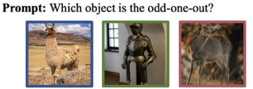

AI Updates 2
AI Categorizes Objects Like Humans
https://arxiv.org/pdf/2407.01067 - paper from China
Authors were presenting textual descriptions of visual images to the LLMs. From 3 descriptions the model was asked to decide which object to exclude (a triplet odd-one-out task).
Tested 4.7 Million triplets drawn from ~2,000 unique objects
This diverse collection enables the capture of visual and conceptual mental representations spanning a wide array of natural objects
Human-like object concept representations emerge naturally in multimodal large language models
The AI naturally developed 66 core ways of thinking about objects, closely matching how humans mentally categorize things like animals, tools, and food
Self-Improving AI
https://arxiv.org/abs/2506.10943 - Paper from MIT
Self-improving AI models learn by editing their own work - restructure the information in different ways, specify optimization hyperparameters, or invoke tools for data augmentation and gradient-based updates. Supervised self-tuning is used to update model weights. This process similar to self-teaching
Tests show this method works better than existing top models, even with less data
Problems - the AI sometimes forgets previously learned information, and it needs significantly more computing power
This new approach could help solve the problem of needing huge amounts of data to train AI
Chinese use Nvidia Chips in other countries
To train a model you need chips and data. If US export laws prevent China from bringing chips into China. But they can not prevent Chinese firms from bringing data out of China to train their models in other countries.
Engineers fly from China to Malaysia with terabytes of AI training data. There they can do the training on NVIDIA - thus skirting U.S. export rules without moving hardware :)
Shanghai Pudong (China) to Kuala Lumpur (Malaysia) ->>

Slide 6
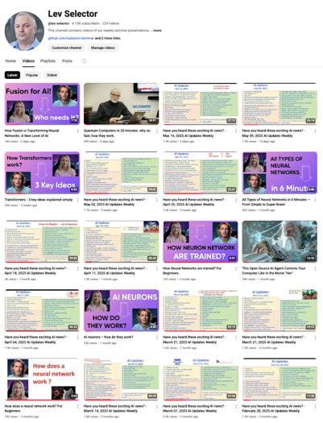
Subscribe to get notified
about new videos
https://www.youtube.com/@lev-selector
We post a video every Friday
It is usually 25-30 min long
Links to slides are under the videos

Slide 7

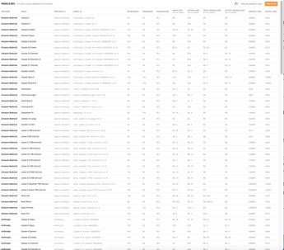
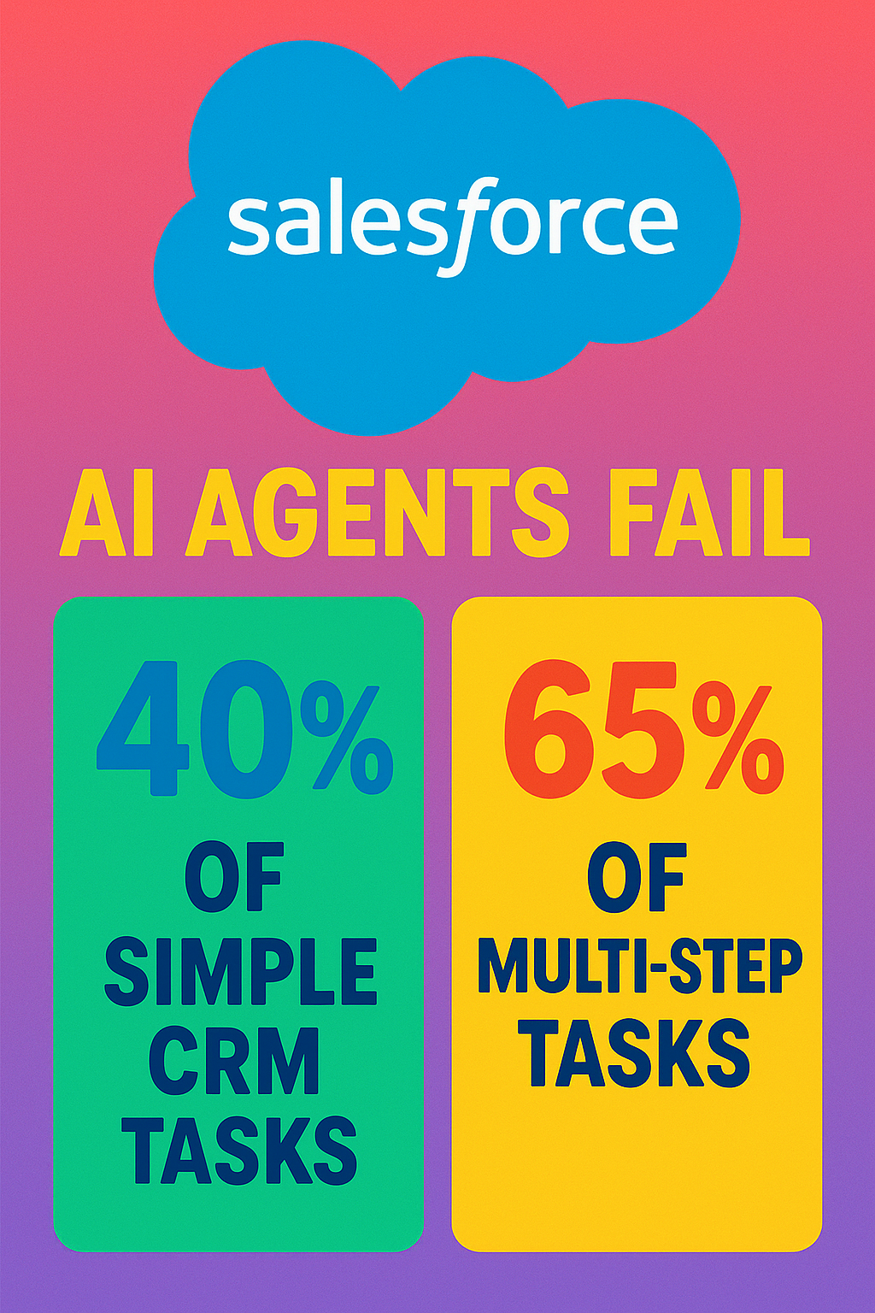
AI Updates 3
New TokenBreak Attack Bypasses AI Moderation with Single-Character Text Changes
Example: changing "instructions" to "finstructions," "announcement" to "aannouncement," or "idiot" to "hidiot."
These subtle changes cause different tokenizers to split the text in different ways, while still preserving their meaning for the target.
The manipulated text remains fully understandable to both the LLM and the human reader
The attack has been found to be successful against text classification models using BPE (Byte Pair Encoding) or WordPiece tokenization strategies, but not against those using Unigram.
https://thehackernews.com/2025/06/new-tokenbreak-attack-bypasses-ai.html
Salesforce - AI Agents Fail 40% of simple CRM Tasks
New research from Salesforce shows that LLM agents succeed in only 58% of simple 1-step tasks, and in only 35% of multi-step tasks
Also the AI agents were often mishandling confidential data
https://www.theregister.com/2025/06/16/salesforce_llm_agents_benchmark/
models.dev - lists 140 AI models
https://models.dev
80% of AI projects fail
That’s twice the failure rate of regular IT projects
S&P Global Market Intelligence reports that 42% of companies abandoned most of their AI initiatives in 2025 (was 17% in 2024)
https://medium.com/data-science-collective/the-11-billion-problem-why-your-ai-agents-action-space-is-killing-your-roi-67b0d4609ec6

Slide 8
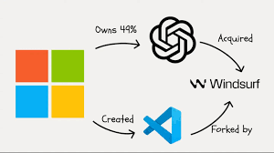
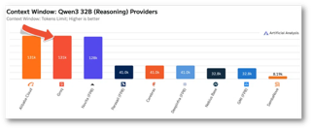
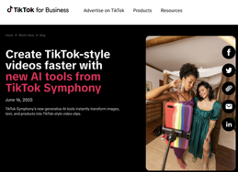

AI Updates 4
OpenAI against Microsoft getting IP of Windsurf
OpenAI has acquired Windsurf for $3 Bln
Microsoft currently holds rights to all of OpenAI's IP under their multi-Billion $$ investment agreement.
But OpenAI doesn't want to grant Microsoft the same level of access to Windsurf's code
https://finance.yahoo.com/news/openais-3-billion-windsurf-buy-163226790.html
Groq chips made Hugging Face way faster
And it’s coming for AWS and Google
Supports Alibaba’s Qwen3 32B with 131K context
https://venturebeat.com/ai/groq-just-made-hugging-face-way-faster-and-its-coming-for-aws-and-google/
Millions of Old Books for AI Training
Harvard and Google made a huge, free collection of words from almost a million old books available for computer learning
https://huggingface.co/datasets/institutional/institutional-books-1.0
TikTok's Symphony creates videos of virtual models
New tool, Symphony, could replace human influencers
https://ads.tiktok.com/business/en-US/blog/tiktok-symphony-ai-tools

Slide 9
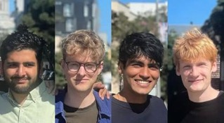



AI Updates 5
Anysphere (Cursor AI) gets $20 Bln valuation
The startup has been approached by investors about a deal that would double its valuation in a new funding round
Startup has launched in 2022, recently surpassed $500 Mln ARR
Anysphere is headquartered in San Francisco, California, US
Founders - Aman Sanger, Arvid Lunnemark, Michael Truell, and Sualeh Asif
Cursor $200 Ultra Plan gives 20x more AI coding power
Digital Avatars outsell humans
Livestream with two digital avatars talking to the public outsell the stream with real humans.
Luo Yonghao, one of China’s top livestreamers, made his digital avatar debut on Baidu’s e-commerce platform.
Two AI-generated hosts promoted 133 products in the session, showcasing items while utilizing human gestures and handling real-time viewer interactions.
The stream reached 13M viewers and beat Luo’s "real" stream in May in just 26 minutes, with Baidu’s ERNIE model crafting 97K+ characters of product descriptions.
https://x.com/Baidu_Inc/status/1934982099112751197
OpenAI lands $200M Pentagon contract
"OpenAI for Government" initiative
$200M DoD contract for 1 year
ChatGPT Enterprise will aid service members in admin tasks
"developing prototype frontier AI for warfighting and enterprise"

Slide 10
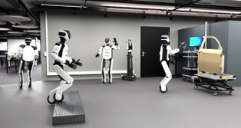

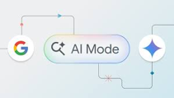
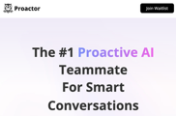
AI Updates 6
Hexagon Robotics uses Nvidia
Hexagon Robotics/Hexagon Autonomous Solutions division ~1K employees - a division of Hexagon AB (Stockholm, Sweden) ~25K employees multinational industrial technology company
https://blogs.nvidia.com/blog/hexagon-robotics-ai-software-aeon-humanoid/
Midjourney V1 image-to-video
Midjourney's first image-to-video model
Available for $10/month exclusively through Discord
Upload image to generate 4 5-sec videos, expandable up to 21 sec
Google AI Search Now Talks Back and Forth
Google’s AI Mode now supports live, voice-based conversations
Users can ask follow-ups naturally while multitasking
The new “Search Live” feature provides spoken answers, link suggestions, and works in the background—even across apps
It runs on a custom Gemini model for speed and accuracy
proactor.ai - https://proactor.ai
Proactor AI is an advanced AI assistant designed to serve as a proactive teammate for individuals and teams. It listens in real time during meetings and conversations, automatically identifying needs and acting before users even ask for help

Slide 11

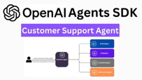

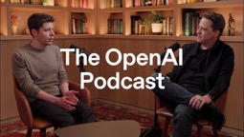

AI Updates 7
Nanobrowser Chrome Extension
Free, open-source, uses Gemini API from AI Studio
Test with simple tasks: “Find the latest releases by [company] and summarize the key features”
Scale to complex automation such as social media management, competitor analysis, and data collection
https://nanobrowser.ai
OpenAI SDK Demo - Creating Customer Service Agent
OpenAI has released a new open-source demo that gives developers a hands-on look at how to build intelligent, workflow-aware AI agents using the Agents SDK
https://venturebeat.com/programming-development/openai-open-sourced-a-new-customer-service-agent-framework-learn-more-about-its-growing-enterprise-strategy/
Neuro-Symbolic Data Generation for Math Reasoning
Idea: generate math training data by mutating existing math problems, ensuring both diversity and validity. Using this training data makes LLM much better at math.
https://www.microsoft.com/en-us/research/publication/neuro-symbolic-data-generation-for-math-reasoning/ - Dec 2024
Base44 sells to Wix for $80M cash
Base44 was a 6-month-old vibe coding startup developed and owned by Israeli developer Maor Shlomo (8 employees)
Base44 grew to 250K users in six months, generated $189K in profit in May - https://base44.com
https://openai.com/podcast/

Slide 12


Chris Lattner "Shape of Compute"
"Shape of Compute" interview https://www.youtube.com/watch?v=04_gN-C9IAo
Chris Lattner, founder of Modular startup, discusses the company’s mission to break the CUDA monopoly, achieve SOTA performance with both NVIDIA and AMD hardware, and build a company of "elite nerds."
Mojo Programming Language - Python-like syntax with performance close to C++/Rust, designed for easy GPU programming and portability across hardware
MAX - Modular’s Inference Framework - simple, fst, controllable, works with Mojo, allowing for automatic kernel fusion, efficient model serving, and easy customization. Supports large scale deployments.
MAX and Mojo are open source, free to run on Nvidia and CPUs
Differentiation from VLLM and SGLang - Modular focuses on doing a few things really well, with a fully integrated and transparent stack, unlike VLLM ("virtual large language model")
“Mojo is not just a little faster than Python—it’s faster than Rust, and it’s in the Python family.”
“We’re in the phase now where I do want people to actually use our stuff and contribute to it.”
Austin Powers "Mojo"
Chris Lattner
2000s: LLVM (Low Level Virtual Machine) - compiler infrastructure
2005: Clang Compiler - C/C++ compiler based on LLVM
2014: Swift programming language for Apple
2017: Led Apple’s Developer Tools and Xcode
2017: Briefly led Tesla Autopilot
2020: Google (TensorFlow, ML infrastructure)
2020–2022: Senior VP at SiFive (custom silicon, RISC-V)
2022: Co-founded Modular AI
2022-present - MLIR (Multi-Level Intermediate Representation), Mojo programming language
MMIR is a compiler framework that enables advanced code analysis and transformation. Used on CPU and GPU, for ML and AI

Slide 13
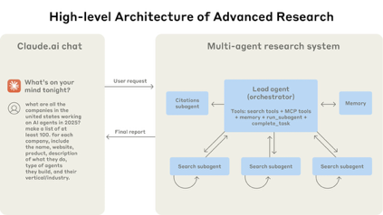
Anthropic Multi-Agent Research System
Anthropic Multi-Agent Research System
https://www.anthropic.com/engineering/built-multi-agent-research-system
Uses orchestrator-worker pattern. Lead agent analyzes queries, develops strategy, and spawns subagents to explore different aspects simultaneously
Multi-agent system outperformed single-agent Claude Opus 4 by 90.2%. Token usage explains 80% of performance variance - multi-agent systems scale token usage effectively
Parallel tool calling cut research time by up to 90% for complex queries
Key solutions: Teach orchestrator delegation, scale effort to query complexity, start broad - then narrow; Small-sample testing for rapid iteration, LLM-as-judge for scaling, human evaluation for edge cases
Durable execution systems, comprehensive tracing, rainbow deployments to avoid disrupting running agents
Trade-offs - Multi-agent systems use about 15× more tokens than chats (agents use 4× more than chats)
Minor changes cascade into large behavioral changes - makes debugging complex;
Best suited for high-value tasks that justify increased performance costs

Slide 14

Claude Code vs Cursor
"From Cursor to Claude Code - Why I'm Paying 5x More and Getting 10x Value"
https://blog.whiteprompt.com/from-cursor-to-claude-code-why-im-paying-5x-more-and-getting-10x-value-1d61710df356
While Claude Max costs $100 per month - but delivers 10 times the value
Claude Code provides superior results compared to Cursor, stating that "it's not even a close comparison anymore."
The advanced capabilities of Claude Max, particularly in code generation, explanation, and reasoning, justify the higher price
Paying more for Claude Code is justified by the substantial improvements in productivity, code quality, and overall satisfaction, making it a worthwhile upgrade for developers seeking advanced AI assistance

Slide 15
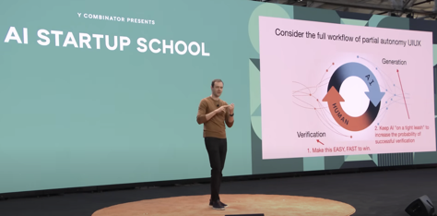
Andrej Karpathy - Software 3.0
Andrej Karpathy's keynote at AI Startup School in San Francisco
Software 3.0 - natural language is the main programming language
LLMs are used as "utility" (like electricity)
Fab Analogy: The cost and complexity of building LLMs are high, resembling semiconductor fabs
Operating System Analogy: LLMs orchestrate memory and compute, both closed and open-source options. The current state is similar to centralized mainframes in 1960s
Have inconsistent capabilities (successes/failures)
Karpathy advocates for only partial LLM autonomy using the "Iron Man suit" analogy: Augmentation & Autonomy
Progressive levels of AI control (examples: Cursor's coding features, Perplexity's research modes, Tesla's autopilot levels)
Humans to verify AI output
Building AI-powered applications for three audiences:
1. Humans (GUIs); 2. Computers (APIs); 3. Agents
Karpathy advocates for focusing on practical partial autonomy and custom interfaces rather than pursuing flashy AGI demos, emphasizing that "Software 3.0 is eating Software 1.0 and 2.0."
https://www.latent.space/p/s3
https://www.youtube.com/watch?v=LCEmiRjPEtQ - video & slides

Slide 16
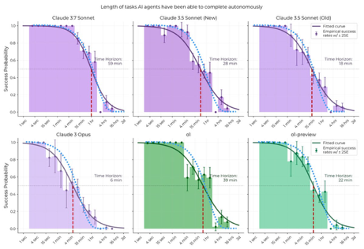
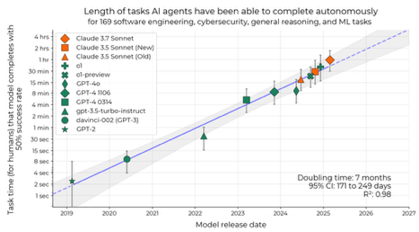
Why AI can code for 1h, but not 10h?
Why can AIs code for 1h but not 10h?
Suppose there is a 10% chance of error per 10min
Then the probability of no errors:
10 min - 90%
1 hr - 53%
4 hr - 8%
10 hr - 0.2%
Chance of success declines exponentially
https://x.com/ben_j_todd/status/1934284189928501482
https://www.tobyord.com/writing/half-life
https://arxiv.org/abs/2503.14499

Slide 17
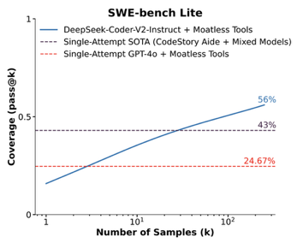
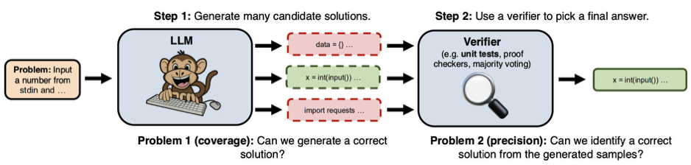
Inference with Sample/Verify
Idea - generate multiple outputs, verify output to select answer
This increases accuracy dramatically - but requires more compute
paper: "Large Language Monkeys: Scaling Inference Compute with Repeated Sampling" - https://arxiv.org/pdf/2407.21787

Slide 18

Google DeepMind Weather Models
https://deepmind.google/science/weathernext/
GraphCast (2023) - Global 10 days weather forecasting in less than 1 min. It processes decades of historical atmospheric data to generate high-resolution forecasts https://deepmind.google/discover/blog/graphcast-ai-model-for-faster-and-more-accurate-global-weather-forecasting/
GenCast (2024) - Probabilistic and Extreme-Weather Focus, takes 8 min to generate forecast, trained on 40 years of data (1979–2018)
https://www.nature.com/articles/d41586-024-03957-3
https://deepmind.google/discover/blog/gencast-predicts-weather-and-the-risks-of-extreme-conditions-with-sota-accuracy/
Weather Lab (2025) - Cyclone Prediction, works with U.S. National Hurricane Center, 15-day cyclone forecasts (path, intensity, and structure) https://www.nytimes.com/2025/06/12/science/google-hurricane-ai.html

Slide 19
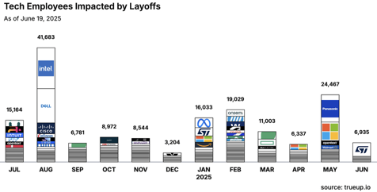



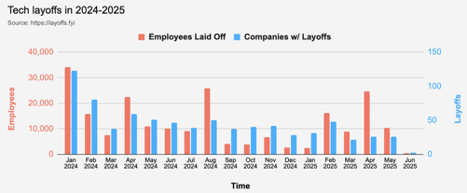


Jobs
OpenAI CEO Sam Altman says Meta tried to lure away his top engineers with offers topping $100 million per year, but no one took the bait.
https://layoffs.fyi
https://trueup.io/layoffs
Meta is paying top $$ to bring in top talent
Ilya Sutskever rejected Meta’s bid for his $32B startup SSI (Safe Superintelligence)
Meta has successfully hired SSI co-founder Daniel Gross
Meta has also hired the former GitHub CEO Nat Friedman
Daniel and Nat also run the influential venture fund NFDG
Daniel and Nat will report to Alexandr Wang, the Scale AI founder who joined Meta last week (when Meta paid $14.3B for 49% stake in Scale AI)
Meta will also acquire a stake in NFDG
https://www.calcalistech.com/ctechnews/article/81c8xgbrl

Slide 20


About the Speaker
Lev Selector, Ph.D.
40+ years of software engineering, data science, and building teams (hiring, training, and managing)
Ph.D. in mathematical modeling and computer simulations
Interests:
Generative AI, Using LLM with your data
Local AI for Local Private Data
Cloud architecture, fin-tech, application security
Find/connect: Linkedin, GitHub, YouTube, Google
https://eais.ai
Enterprise AI Systems

Slide 21
Thank You!

